Slide 1
A CLEAR SOLUTION FOR TROUBLED WATER
The Floating Waste Water Treatment Plant

Slide 2
The greatest source of health problems is waterborne bacteria, viruses and parasites coming from raw sewage, infected feces and industrial biowaste that are not adequately sanitized before entering the water supply.
1.1 billion people lack access to safe water
2.6 billion people lack access to proper sanitation

Slide 3
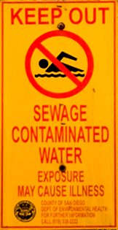
Sewage represents a severe threat to human health and to the marine environment.
It can make beaches potentially hazardous to all forms of life.
It often contains harmful chemicals, contiminants, disease-causing bacteria and viruses, and dissolved material and solid matter.

Slide 4
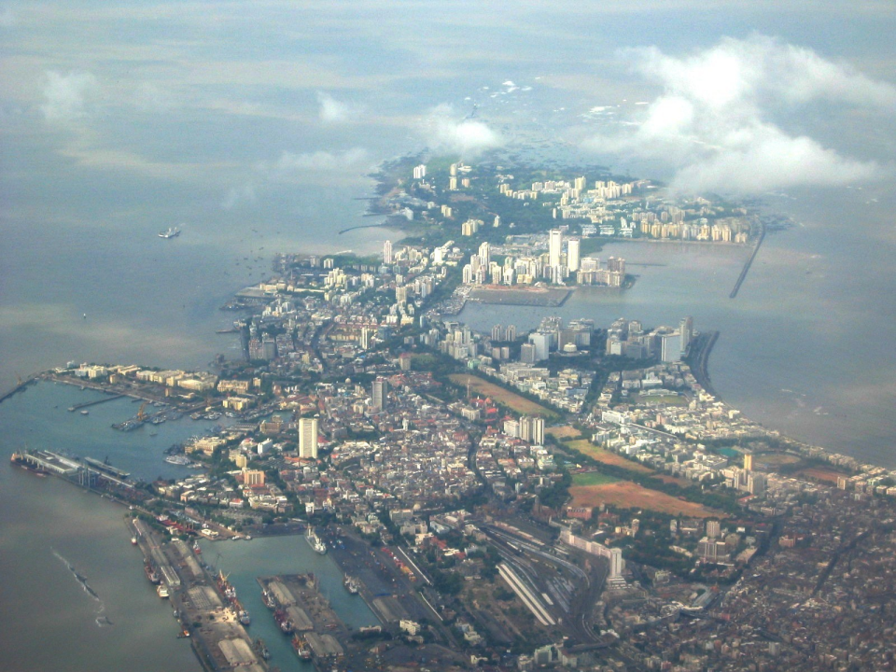
More than half of the world’s population lives within a 100 km or 60 miles distance from the coast. Coastal populations continue to grow. So do sanitary concerns.

Slide 5
In most coastal areas where cities and towns are located, every available square meter of land area is used. Available sites for land based treatment facilities is limited .

Slide 7
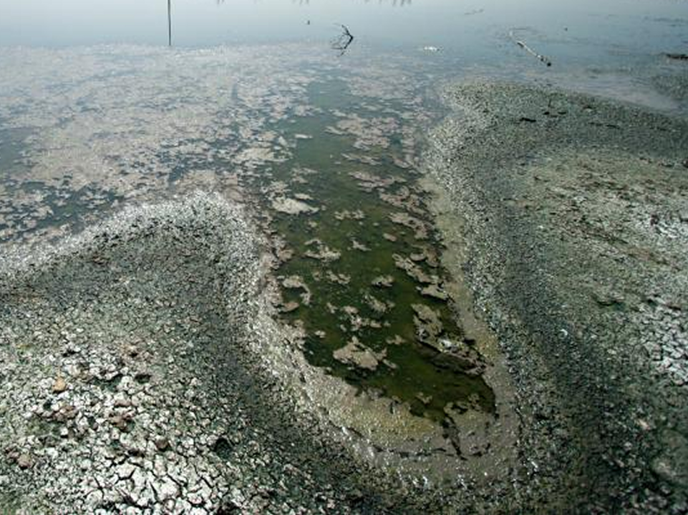
The question is not what to do with the wastewater.
The answer is clear: Treatment.
The question is where and how?

Slide 8
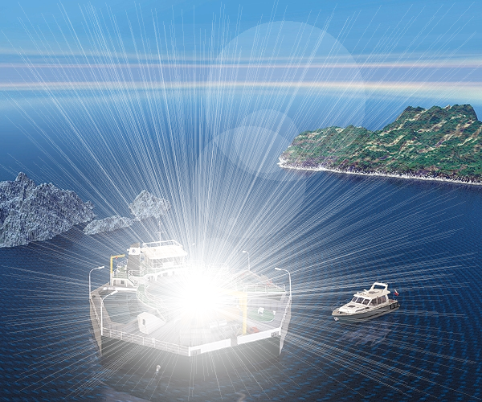
There is a system that solves the problem of coastal wastewater pollution
a floating
waste water
treatment plant

Slide 9
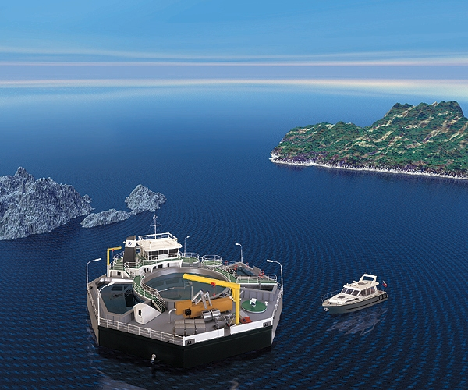
The Waste Water Treatment Plant is placed on a floating platform which is anchored in a suitable distance from the city or village it serves

Slide 10
An underwater pipeline provides the connection between an existing sewer system and the floating treatment plant

Slide 11
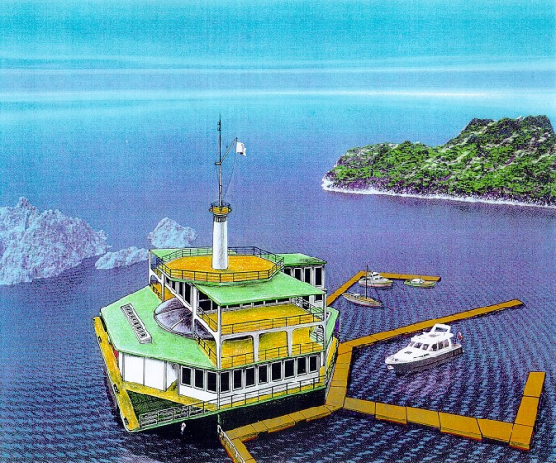
Seen from the shore, the treatment plant does not have to be an eyesore. A superstructure can be designed in multipurpose variations.

Slide 12
The superstructure over the operating hall roof may be constructed as a beacon or light tower. It could also be a coast guard or harbor police station

Slide 13
This rendering suggests a marina (including a clubhouse or restaurant), with floating moles to moore yachts

Slide 14
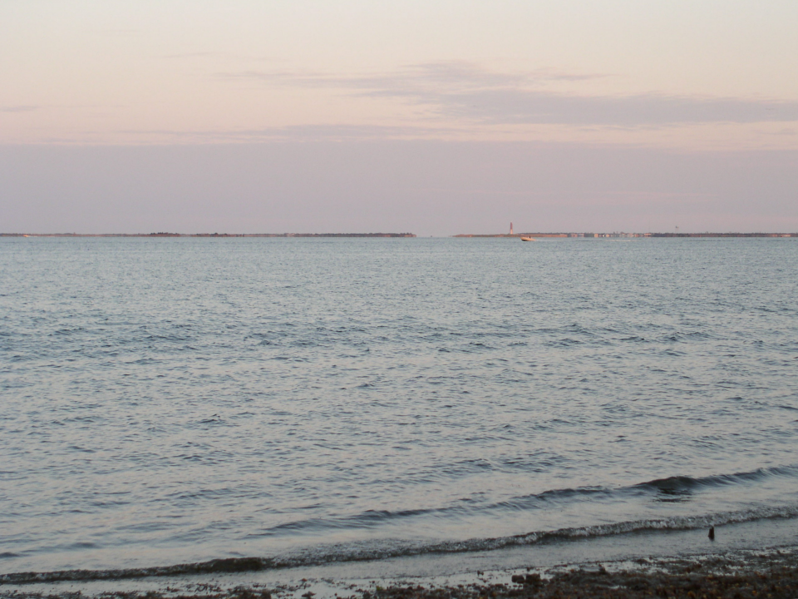
The Floating Waste Water Treatment Plant would be anchored a suitable distance from the city or village it serves within a protected bay, or behind and existing or specially constructed breakwater, or in a lake.
Compared to the construction of a land-based treatment plant, a floating wastewater treatment plant eliminates many time and procedural problems, and offers significant advantages.

Slide 15
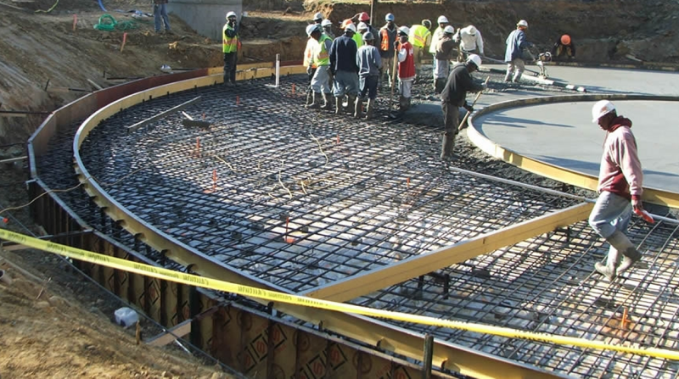
No land based construction costs; is thus more economical.
No land appropriation; freeing space for other development.
Fast installation; mainly pre-fabricated at an industrial facility.

Slide 16
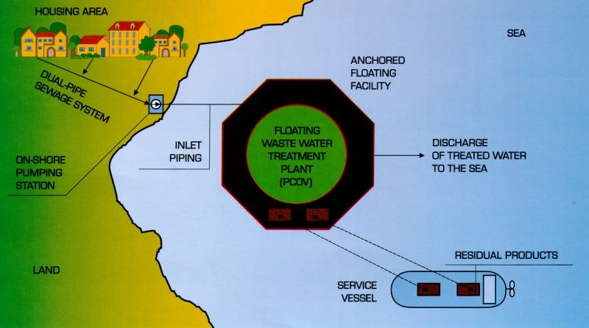
The plant can be hooked to any existing canal system in a matter of days and can start to treat the sewage that otherwise is dumped in the costal waters.

Slide 17
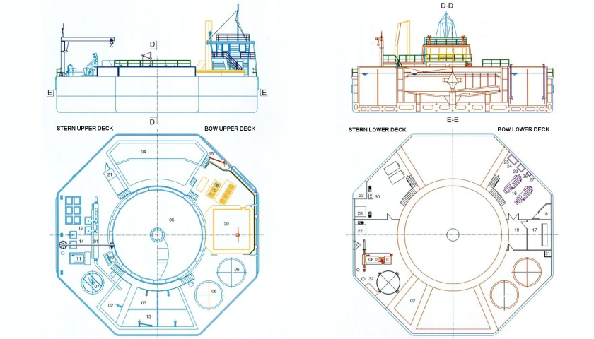
Floating Waste Water Treatment Plant For 5‘000 Residents - Basic Module

Slide 18
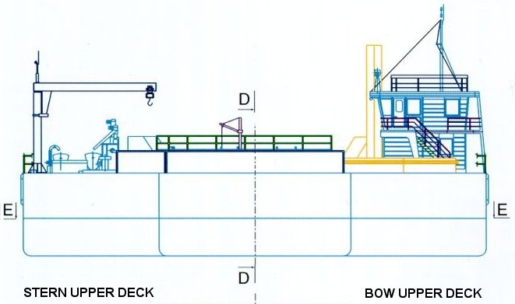
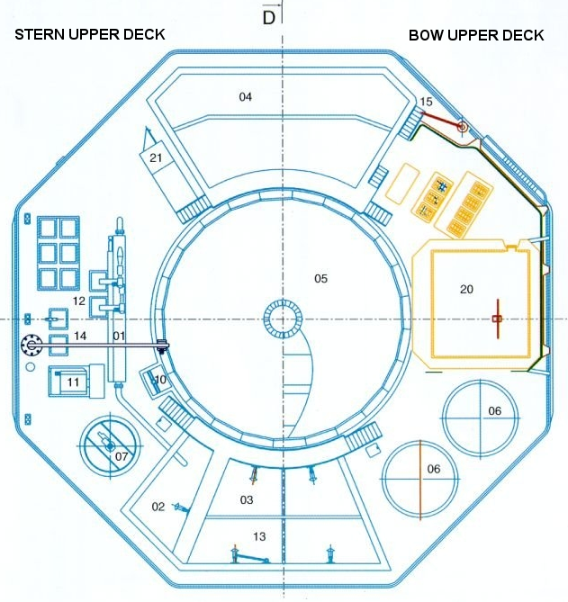
01 Mechanical rough separation
02 Contactor tank
03 Denitrification tank
04 Nitrification tank
05 Settling-up tank
06 Sludge storage tank
07 Homogenisation tank
10 Overflow well
11 Drum filter
12 Containers
13 Lifting equipment for mixers
14 Crane, 3.2 metric tons
15 Crane, 1.0 ton
20 Operator‘s cabin
Lower deck entrance

Slide 19
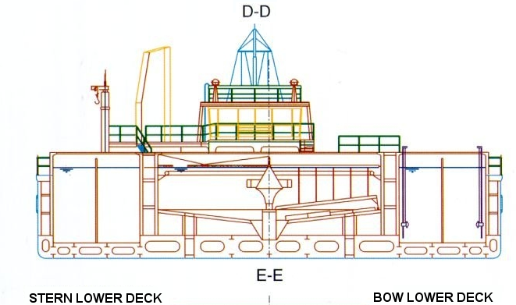
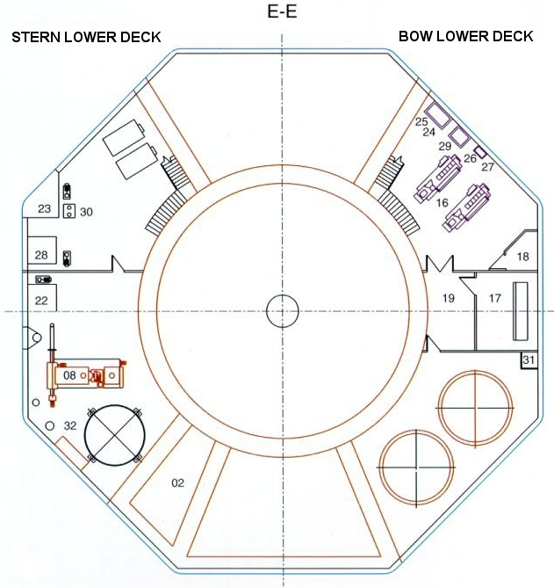
02 Contactor tank
08 Mechanical sludge pressing
16 Gensets
17 Main switchboard
18 Storage batteries
19 Workshop
22 Drinking water reservoir
23 Diesel oil storage tank
24 Lubrication oil storage tank
25 Diesel oil operation tank
26 Lubrication oil operation tank
27 Expansion cooling tank
28 Drainage water and machine sludge tank
Waste oil storage tank
Diesel oil purification
Fecal sump
Chemical treatment

Slide 20
THE
FLOATING WASTE WATER TREATMENT PLANT
A Clear Solution For Troubled Water

